Slide 1
ANDROID TDD BOOTCAMP

Slide 2
Agenda
Objective
Importance of tests
Testing Paradigms
MVVM
Test drive the Conference App

Slide 3

OBJECTIVE
http://blog.commlabindia.com/wp-content/uploads/2011/06/target.jpg
Notes:
Introductions
Name Tags
As we have all assembled here, all of you all must have thought about what is it that we are going to achieve in these three days? While working on your projects, what prompted you all to attend a workshop related to TDD? Looking at the workshop description, what was do you all think about TDD?
So, in these three days, we will test drive an Event/Conference application and we go through some patterns like MVP n MVVM to achieve a fully functioning application through TDD.
How many of yall have written some kind of tests?

Slide 4

WHY DO YOU WRITE
TESTS?
http://nccscurriculum.org/wp-content/uploads/2016/05/codinggirl.jpg
Notes:
Every small change you have to deploy and it takes time, fast feedback is not available. Productivity loss...Development cycle..Manually one has to check
Take an example and brainstorm with some benefits

Slide 5
DOCUMENTATION
ALLOWS REFACTORING
CODE WORKS
REDUCES
BUGS
TESTS
TIME TO MARKET IS LESS
CLEAN INTERFACE
Notes:
Clean Interface - Because programmers write the test first, the APIs they produce are naturally written from an API-user perspective.Resultantly, these APIs are far easier to use than those written by programmers more concerned with the internal workings of their packages. Helps improve your design - It can help one think about the responsibilities of the class and what is the collaboration with diff classes
Proves your code actually works - u develop features incrementally and as you write each block of code, you can test them individually
Refactoring - As tests create a safety net, and your scenarios are in place, one can improve the logic, and while doing so any bugs introduced could be caught by tests. When a change is made to the application, all that must be done is run the existing test cases to see if the change has adversely impacted any other piece of the application. This removes all roadblocks from updating legacy applications and making changes within the current development. This has clear benefits for young companies seeking rapid growth, older organizations who need to update legacy systems, and organizations who want to diversify service options or revenue channels.
Documentation - test describe the functionality and behaviour of your system
Helps catches bugs around important aspects of the code - Legal link
Deployments faster

Slide 6
Testing Paradigms
Unit Tests
Test Pyramid
Junit
Test Fixture
Phases of Test
TDD
Notes:
In this session we will go through the test paradigms. Let’ take one example to understand this. For example you are developing an application for which user login is required. When user enters the credential, you have to validate them and on successful validation you have to make a server call. After getting the successful response, you want to go to the home page.
If for this you want to write tests, what kind of tests will you write? If you write this test as end to end then you have to go through activity flow and then you have to check. Idealy you should be able to write test for a small piece of code like validation. Where No android component is required. Just pass email and password and then validate based on certain conditions. Right? So this small piece of code which is called as unit can be independently tested by writing tests, which is called unit test. And this is called functional test.
Have you guys seen this diagram?
What does this diagram say?
Test Pyramid is a concept developed by Mike Cohn, described in his book - “Succeeding With Agile”. Its essential point is that you should have many more low-level unit tests than high level end-to-end tests running through a GUI.
What is Unit Testing?
Unit testing is a software development process in which the smallest testable part of your application which is called unit, can be independently scrutinized. In procedural programming, unit can be whole module but in terms of Object Oriented Programming unit means a single class or method of the class.
For example, in your application there is a feature called login, where you asks user to enter the email address and password, then you validate these credentials and then send a login request to the server and go to the home page on success of the login request. Now if you want to write test for this feature, what kind of tests you should write?
As a unit level u should be able to write tests for login validation. The tests which validates, makes request and then navigate to the home page should be at the integration level, will talk about integration and functional level of test pyramid whenever we will be having a need in this three day workshop.
What is Junit? Junit is a unit testing framework for java and is one of a family of unit testing frameworks which is collectively known as xUnit.
In this xunit architecture there is a concept called text fixture. Does anybody know what is test fixture?
A test fixture is something used to consistently test some item, device, or piece of software. It’s a generic term which can be used in context of Electronics also. In software terms, test fixture is the fixed state of software which is required to test some operations being performed on the software. For example, we are talking about Login scenario right, Lets say that you have auto login as a feature in your app, what does that mean is whenever user successfully logs in we store the user’s credentials and then do auto login from the login page. To test the auto login scenario, we will store the data in the database as a test fixture.
There are four phases of test
Set up - Setting up the test fixture
Exercise - Perform operations to be tested
Verify - Verify the output after the operations being performed
Tear Down - Tear down the test fixture to return to the original state
Example on slide
TDD - Red Green Refactor cycle

Slide 7
Assignment 1
Problem statement:
Determine whether a node can be reached or not

Slide 8
Assignment 2
Problem statement:
Determine the number of hops between two nodes

Slide 9
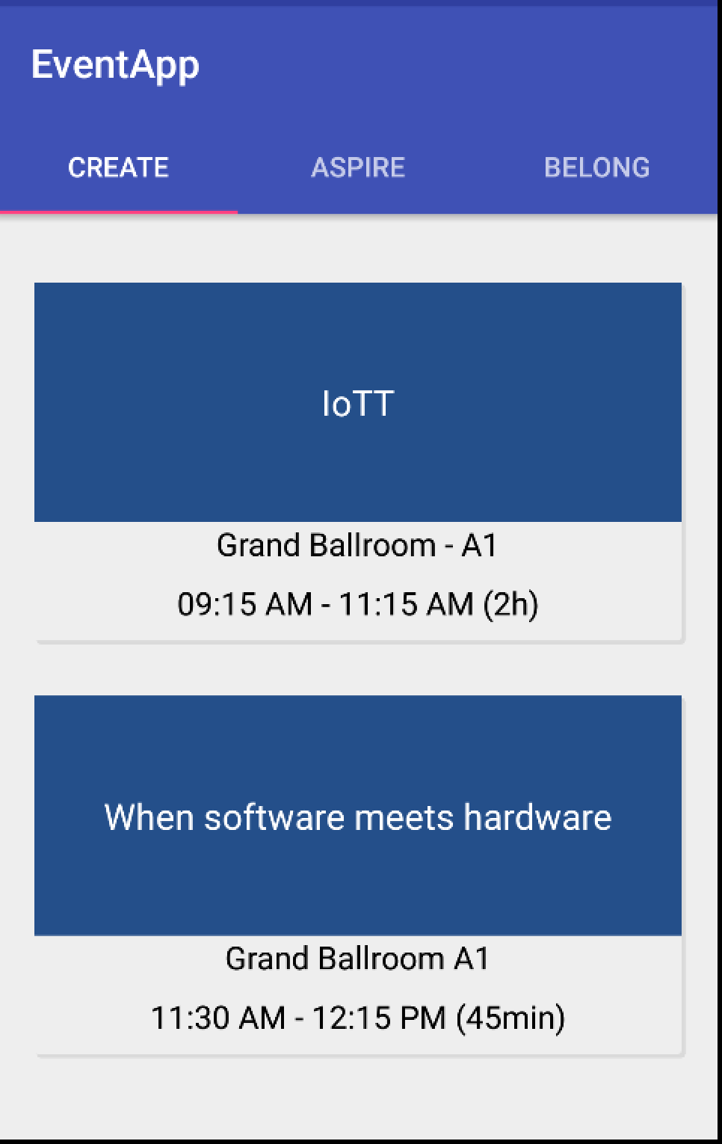
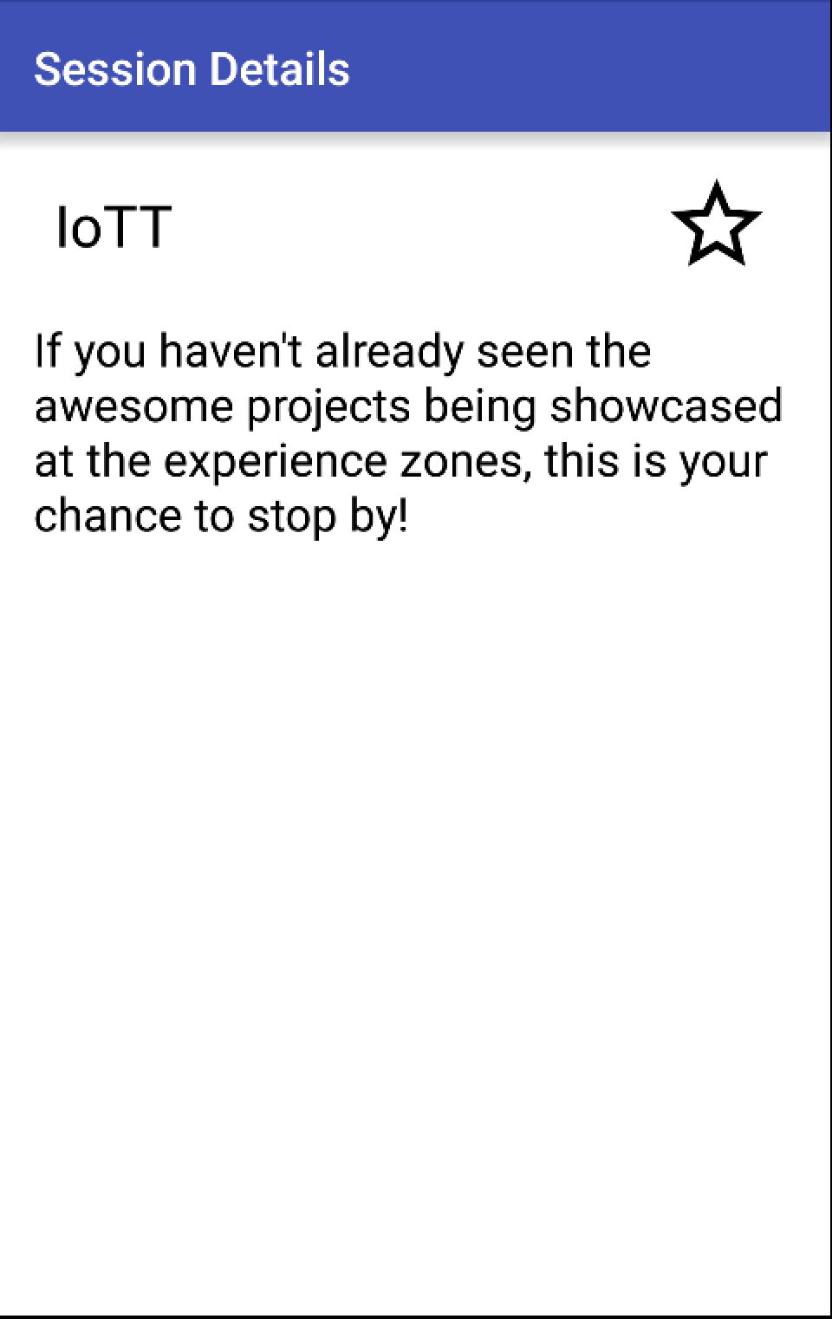
Application Context
Notes:
Skeleton walkthr

Slide 10
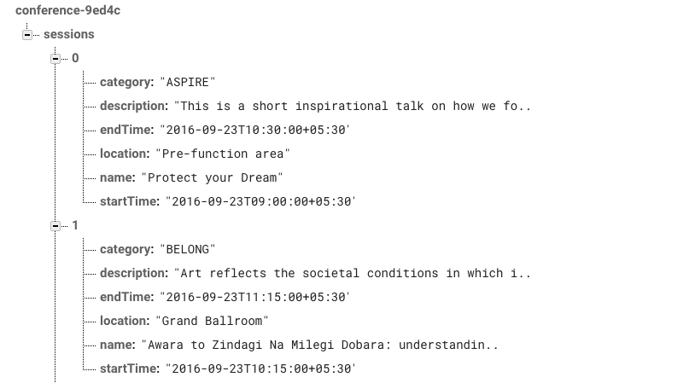
Test Data
Notes:
Skeleton walkthr

Slide 11
Acceptance Criteria
Show the sessions based on categories

Slide 12
Assignment 1
Filter sessions based on Category - ASPIRE, BELONG, CREATE
Get sessions for CREATE category
Generalize the solution for any category

Slide 13
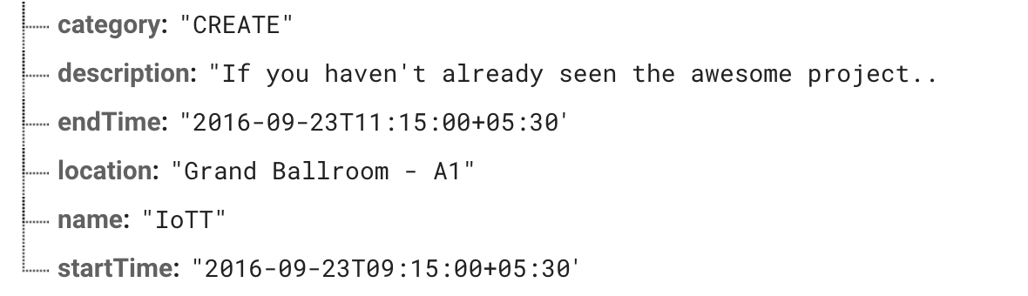
DISPLAYING THE DATA
Notes:
1. Compare the contract of the model and view
2. Ask if it is directly mappable
3. Where to do the formatting?
4. Formatting in Model and Activity - what are the problems? Activity will require deploy, and won’t be unit testable. Model - it will tightly couple UI concerns with the Model. In future, supporting different UI will introduce unnecessary code in the model.
5. Compare with the billboard example
6. Introduce MVVM
7. MVVM Theory and history
8. Relationship between each component in MVVM

Slide 14
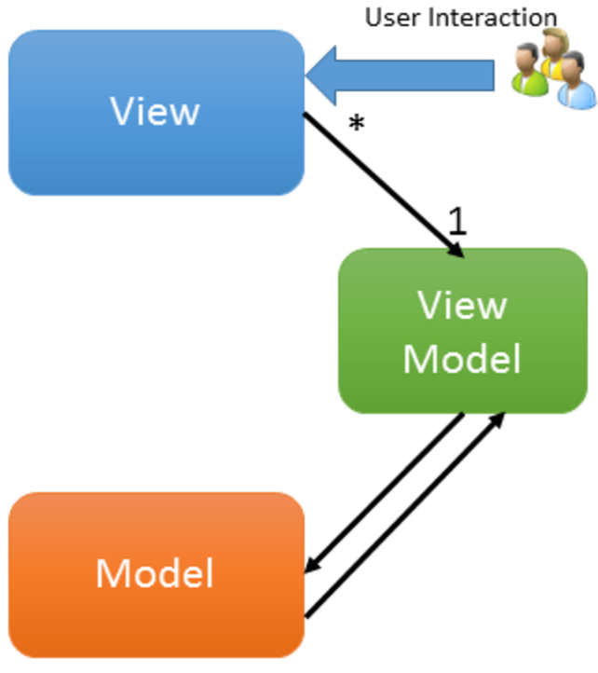
MVVM
Notes:
MVVM evolved with the .Net platform.
MVVM comprises of three components -
-View (UI)
-Model (Data displayed in UI)
-Glue code (Event handling, binding, orchestration)
In the traditional MVVM Model, the ViewModel takes the Model, and massages the data to display it on the View. The View and Viewmodel are bound to each other using Databinding. So any events on the UI are consumed by the View Model, who then decides what action to take.
Data retrieval, and business logic are all taken care of by the View Model.
MVVM as a concept was developed to make it easy to engage in Event Driven programming, where every application state change is driven by an event.

Slide 15
Assignment 2
Create a View-Model, which massages data into the exact format that is needed by the UI.

Slide 16

FEEDBACK
http://blog.commlabindia.com/wp-content/uploads/2011/06/target.jpg

Slide 17
Recap - Day 1
The benefits of the test
Testing Paradigms
TDD
MVVM

Slide 18
Agenda - Day 2
Espresso
MVP
MVP + MVVM

Slide 19

TEST DRIVING THE VIEW
http://nccscurriculum.org/wp-content/uploads/2016/05/codinggirl.jpg
Notes:
What do you test on the View? - Value of elements, and Actions.
How would you slice the test, and what test would you write, if you’re driving it from scratch ? Do you mock the layers behind the UI, or keep them?
Once all layers governing logic are built, there has to be some layer which tests the vertical slice. Having the UI test traverse the whole vertical slice ensures that an integrated test of the whole component is done at some point.
Position on the Test Pyramid. - This is an integration test. Unlike integration tests on web framework, this is a vertically sliced integration test, and not horizontally sliced. The job of this test is to test one vertically sliced UI.
What framework to use? Android Instrumentation - described more on the next page.

Slide 20
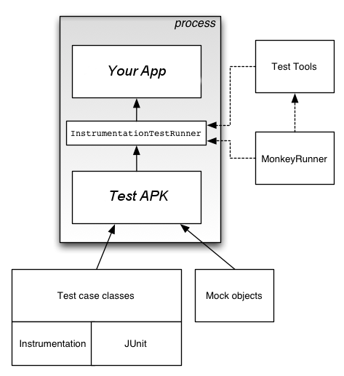
ANDROID INSTRUMENTATION
http://blog.commlabindia.com/wp-content/uploads/2011/06/target.jpg
Notes:
Android instrumentation is a set of control methods, or hooks, in the Android system. These hooks control an Android component independently of its normal lifecycle. They also control how Android loads apps.
Using Instrumentation, you can have hooks to various Android component lifecycles and events. Moreover, you can trigger those lifecycles and events. Since it is in the same process, you can trigger interactions with the UI.
An Instrumentation Test will actually run the Application on the Emulator, and is not a mock.
Reference - https://developer.android.com/studio/test/index.html
What are the problems with Instrumentation?
Since it is running on a different thread, after every action, we have to request the application to get idle on it’s main thread before the test moves. Else, the test has to put in sleep statements. Contracts such as findViewById, and then click make it very verbose. Any powerful interactions have to be custom defined.
The problems that happen with Instrumentation are covered by another Framework introduced by Google - Espresso

Slide 21
ESPRESSO
Espresso
ViewMatchers
ViewActions
ViewAssertions
Notes:
Espresso – Entry point to interactions with views (via onView and onData). Also exposes APIs that are not necessarily tied to any view (e.g. pressBack).
ViewMatchers – A collection of objects that implement Matcher<? super View> interface. You can pass one or more of these to the onView method to locate a view within the current view hierarchy.
ViewActions – A collection of ViewActions that can be passed to the ViewInteraction.perform() method (for example, click()).
ViewAssertions – A collection of ViewAssertions that can be passed the ViewInteraction.check() method. Most of the time, you will use the matches assertion, which uses a View matcher to assert the state of the currently selected view.
Example -
onView(withId(R.id.my_view))
.perform(click())
.check(matches(isDisplayed()));

Slide 22
Assignment 3
Verify that the View is consuming data from the View Model and rendering it on the UI
Container view model to host session view models
Assert UI on view
Notes:
Fragment Test Rule

Slide 23
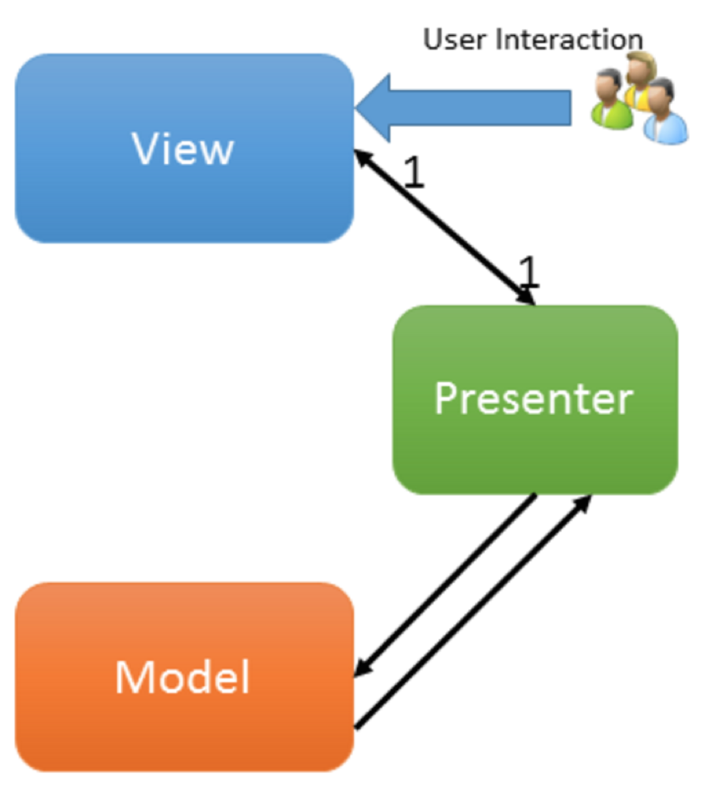
Model-View-
Presenter
Notes:
MVP is Model-View-Presenter pattern which helps to isolate View from the business logic and make it thin but unlike MVVM there is no Binder who can binds data on UI and keep them in Sync. That should be done by writing boiler plate code as we do in MVC.
The responsibiliy of View and Model and collaboration between them stay same as MVVM.
Here, Presenter is responsible for handling user interaction triggered on View and is also responsible to update View based on the requestee action is performed on Model which means it knows about View.
View also knows about Presenter as it delegates the user interaction command to presenter and not aware about any business logic.
Here you can see that there is one to one mapping between Presenter and View as both knows about each other and View should hold only one presenter at a time.

Slide 24
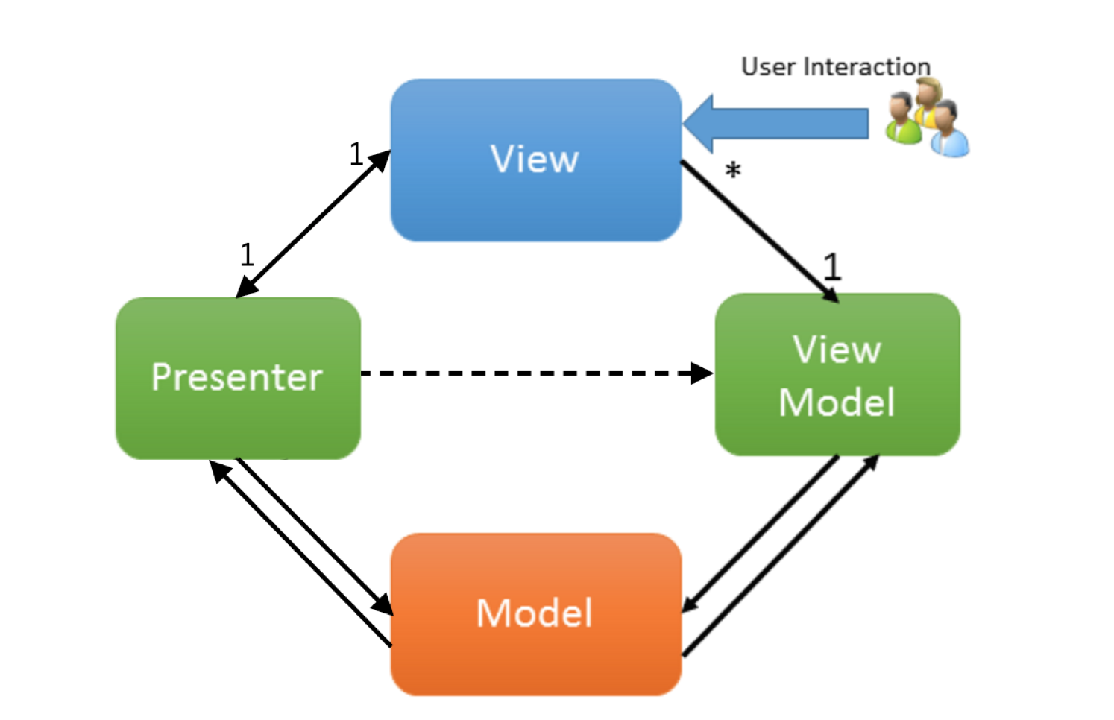
MVP - MVVM
Notes:
MVP is Model-View-Presenter pattern which helps to isolate View from the business logic and make it thin but unlike MVVM there is no Binder who can binds data on UI and keep them in Sync. That should be done by writing boiler plate code as we do in MVC.
The responsibility of View and Model and collaboration between them stay same as MVVM.
Here, Presenter is responsible for handling user interaction triggered on View and is also responsible to update View based on the requestee action is performed on Model which means it knows about View.
View also knows about Presenter as it delegates the user interaction command to presenter and not aware about any business logic.
Here you can see that there is one to one mapping between Presenter and View as both knows about each other and View should hold only one presenter at a time.

Slide 25
Assignment 4
Verify Presenter makes a call to APIClient to fetch data from the server
Notes:
The purpose of mock is to eliminate testing all the dependencies of a class or function so your tests are more focused and simpler in what they are trying to prove.
A mock is something that as part of your test you have to setup with your expectations. Mocks in a way are determined at runtime since the code that sets the expectations has to run before they do anything.
Tests written with mocks usually follow an initialize -> set expectations -> exercise -> verify pattern to testing.

Slide 26
Assignment 5
Verify Presenter tells View to render list of sessions filtered by category on successful API response
Notes:
Agenda Fragment and Agenda Presenter
Stub you have already written with predetermined behavior. So you would have a class that implements the dependency (abstract class or interface most likely) you are faking for testing purposes and the methods would just be stubbed out with set responses. They wouldn't do anything fancy and you would have already written the stubbed code for it outside of your test.While the pre-written stub would follow an initialize -> exercise -> verify.
Do Answer

Slide 27
Assignment 6
Verify Presenter tells View to show Progress Dialog while fetching data from server
Verify Presenter tells View to dismiss Progress Dialog on successful API response
Notes:
Inorder

Slide 28
Assignment 7
Verify Presenter tells View to show Error Dialog on API failure response
Verify Presenter tells View to dismiss Progress Dialog on API failure response

Slide 29
Homework
Display all data as per the mockup
for Home screen

Slide 30
Recap - Day 2
MVP
MVP + MVVM
Mockito
Espresso

Slide 31
Agenda - Day 3
Show sessions
Conflicting sessions
Functional Test
Open Space

Slide 32
Assignment 8
Verify one can swipe to the second Tab and see formatted duration for session 1
Test swipe
Test for formatted date in the view
Notes:
Container Fragment
Ambiguous match error

Slide 33
Assignment 10
Verify the category as title are being displayed on the UI

Slide 34
Assignment 11
Verify that Detail Activity is launched when user clicks on any of the session from the session list
Notes:
Intending - Intended
Intent.init()
Intent recording
Intent.release()

Slide 35
Assignment 12
Verify that session is being saved and show Toast on successful save
Notes:
1) Click on star -> saves to repo - Unit or Integration?
2) Integration test to test repo
3) Toast - Unit and Integration
5) View Model - tells which drawable to render - Unit - TODO
6) View Model - Action Bar label - To talk about

Slide 36
Assignment 13
Verify that Dialog is displayed when user selects conflicting session
Notes:
Once in production, additional feature how tests can give confidence

Slide 37
FUNCTIONAL TEST
Notes:
We have covered Unit and Integration level tests so now what could be our functional level test?
Ok,
Now how will you write tests for it? Any idea?

Slide 38
OPEN SPACE

Slide 39
Community
Twitter
@Nzneen
@sagar_bhat
@jigishchawda
ThoughtWorks India Geek Lounge - Facebook Lounge

Slide 40
FEEDBACK
http://blog.commlabindia.com/wp-content/uploads/2011/06/target.jpg

